Slide 1
A Sip in the Right Direction
Team 38 - Byte Club 👊
February 11, 2024
Notes:
Take a sip in the right direction with us

Slide 2

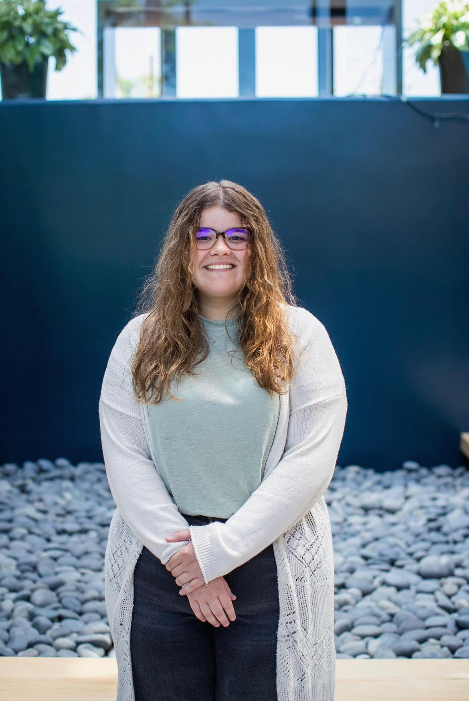




Intros

Slide 3
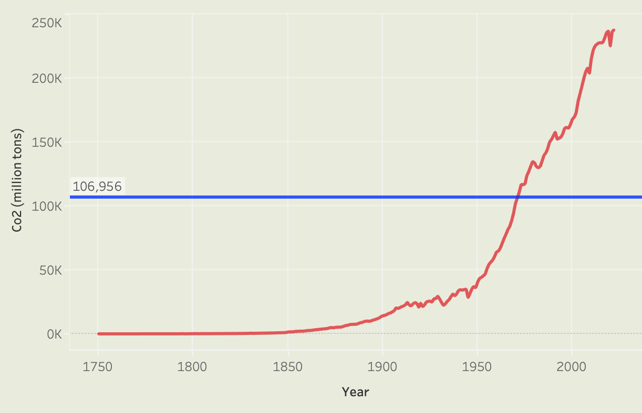
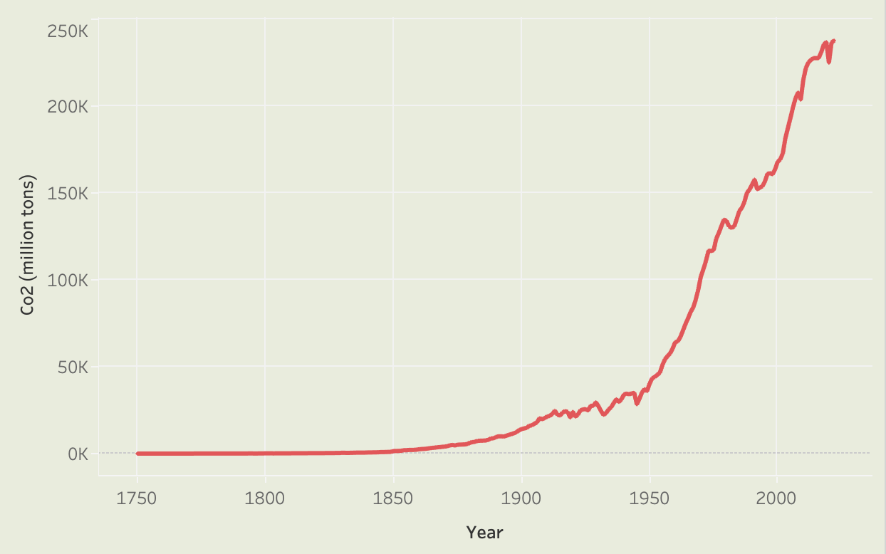
Climate Change

Slide 4
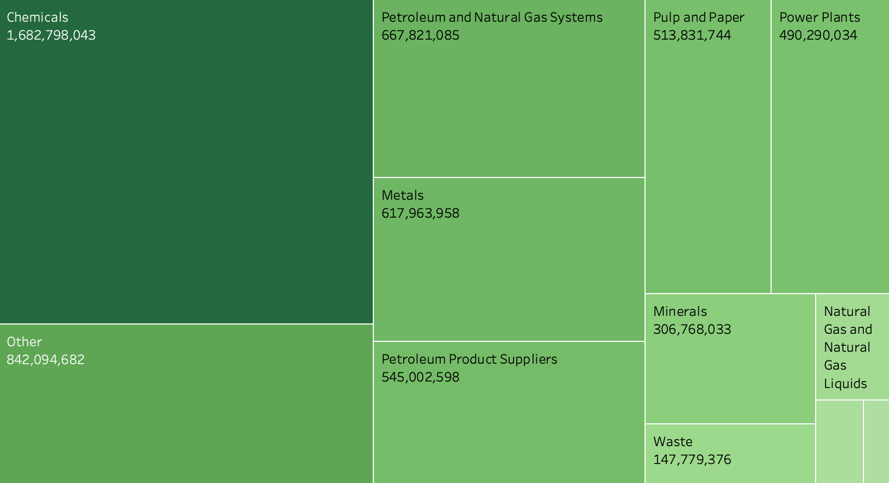
Sector by Total CO2 emissions (metric tons)

Slide 5
Tackling Big Oil is Hard.

Slide 6
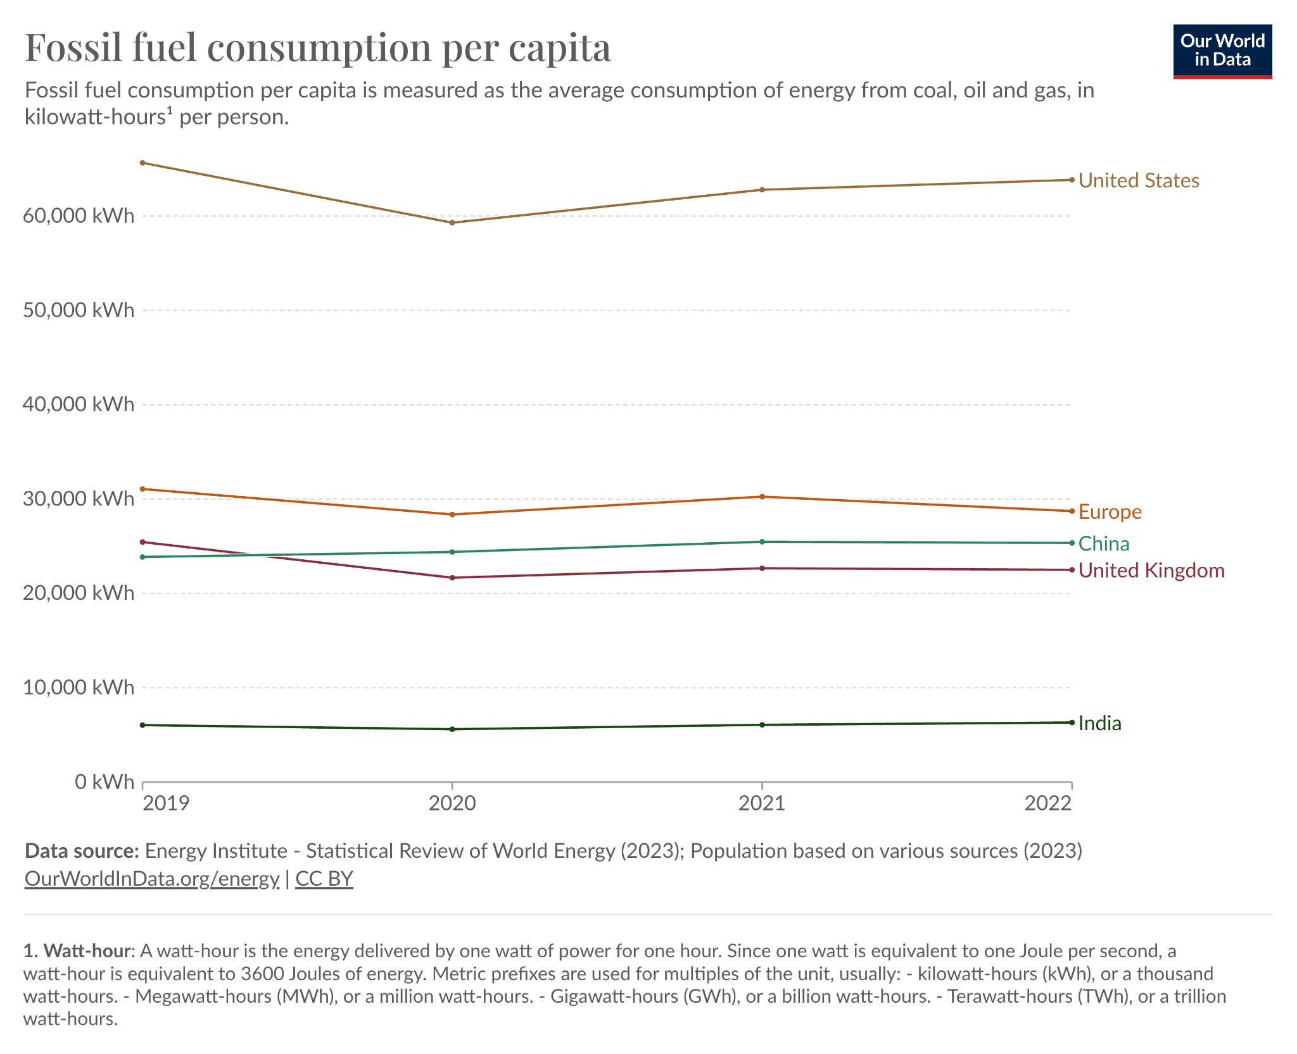
No signs of slowdown
So what can we do?

Slide 7
Sector by Total CO2 emissions (metric tons)

Slide 8
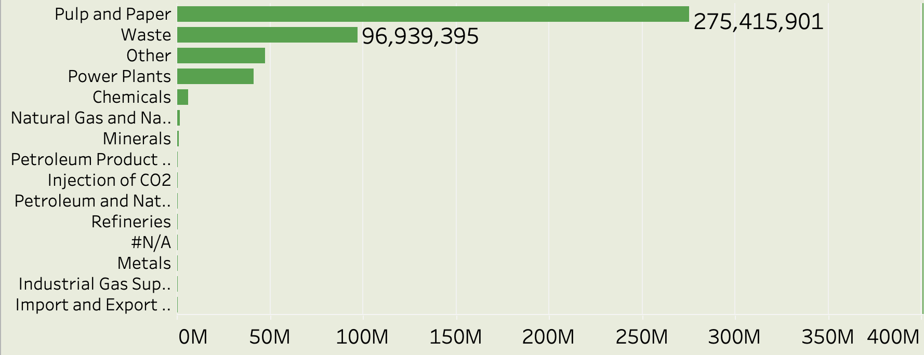
Sector by Biogenic CO₂

Slide 9
The Problem with Paper:
Trees suck.
(kind of)

Slide 10
20-80 years to mature
<50% Cellulose
20-35% Lignin
Can be recycled 3 times

Slide 11
20-80 years to mature
Matures in 100 days
<50% Cellulose
Up to 80% Cellulose
>20% Lignin
5-24% Lignin
Can be recycled 3 times
Can be recycled 8 times
Notes:
Hemp also absorbs 2X as much CO2

Slide 12
30 - 40%
~41,000,000
~150,000,000
Reduction in biogenic CO2 emissions
Additional metric tons of CO2 absorbed
Metric tons of CO2 saved annually

Slide 13
How can we leverage the benefits of hemp paper to reduce emissions at an industrial scale?

Slide 14
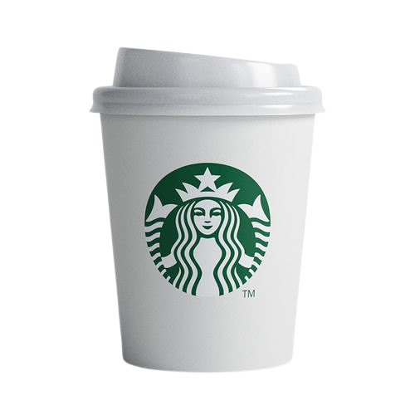
Starbucks
38,500 +
1 Billion
$110+ million
locations in the world
plastic straws eliminated worldwide
for sustainability research and infrastructure
Notes:
Atul

Slide 15
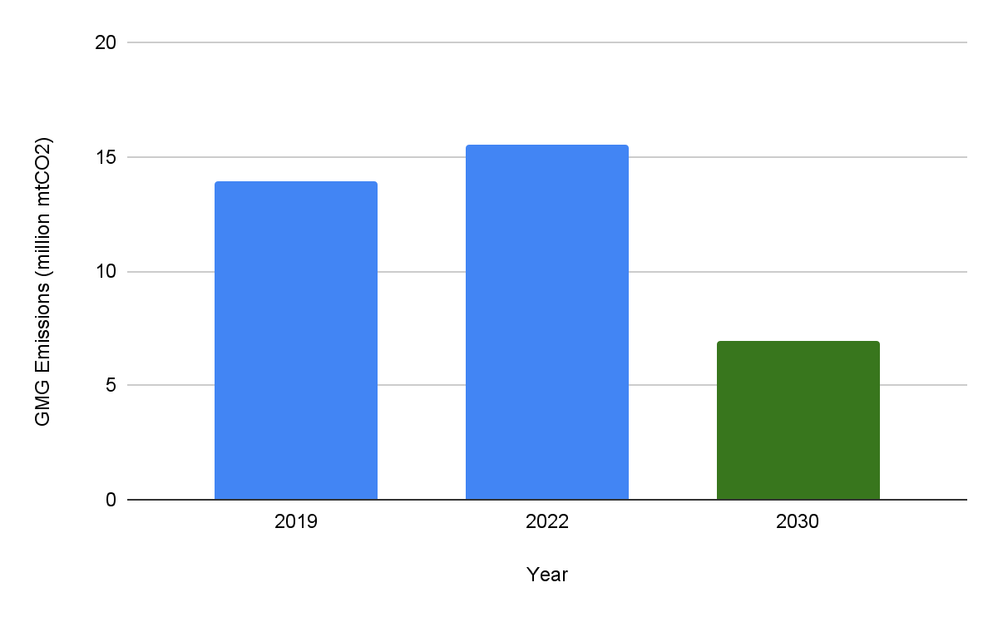
GHG Emissions by Year
Notes:
Atul

Slide 16
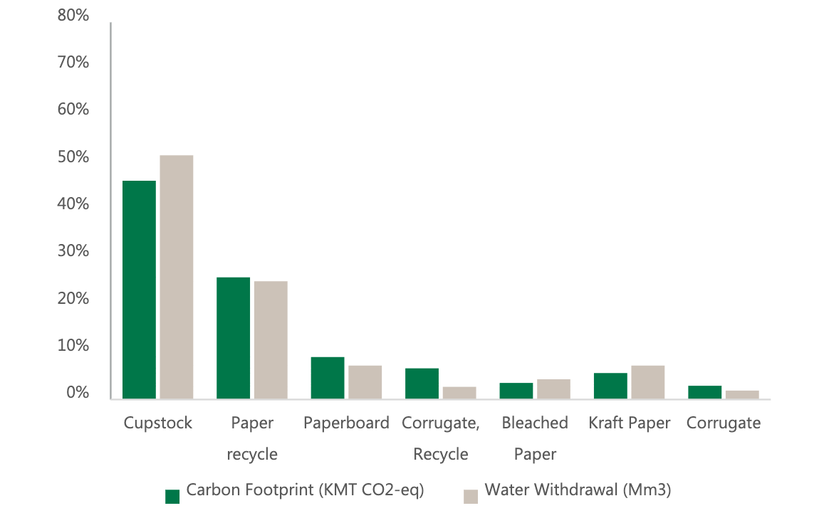
Notes:
Atul

Slide 17
600,000,000,000
“Each year, an estimated 600 billion paper and plastic cups are distributed globally and though Starbucks cups only account for an estimated 1 percent of that total, the company is not leaving the problem-solving to others.”
Starbucks 2023 CDP Climate Change, Water Security and Forests Response
Notes:
Atul
“They want to be involved so let’s involve them”

Slide 18
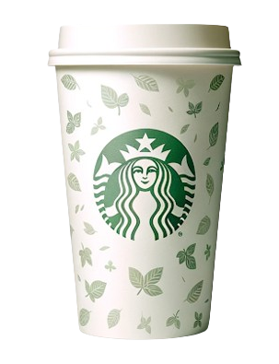
Solution
Hemp paper cup
Notes:
Alan

Slide 19
Starbucks Emissions REDUCED BY OVER 24,000,000 lbs. CO₂
Notes:
Alan

Slide 20
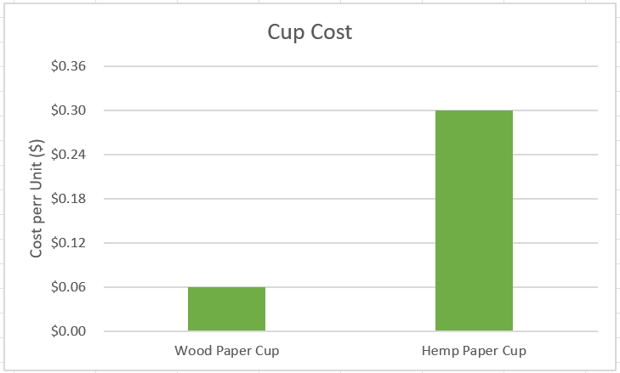
Problem: hemp paper is more expensive.
Solution? Raise prices.
Notes:
Alan

Slide 21

ECONOMICS
86%
2x
of millennials are interested in impact investing
Millennials are twice as likely to invest in funds targeting social or environmental causes than the general population

Slide 22
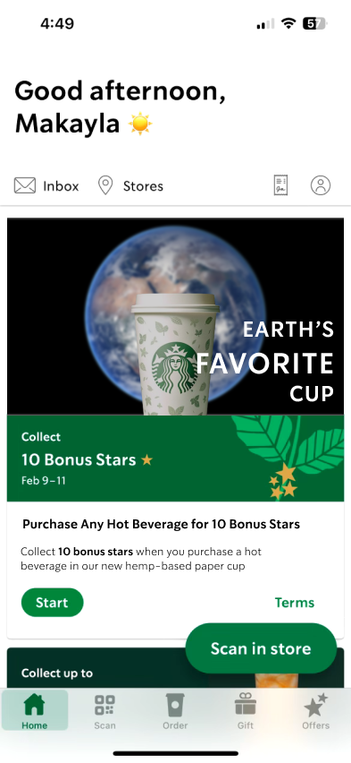
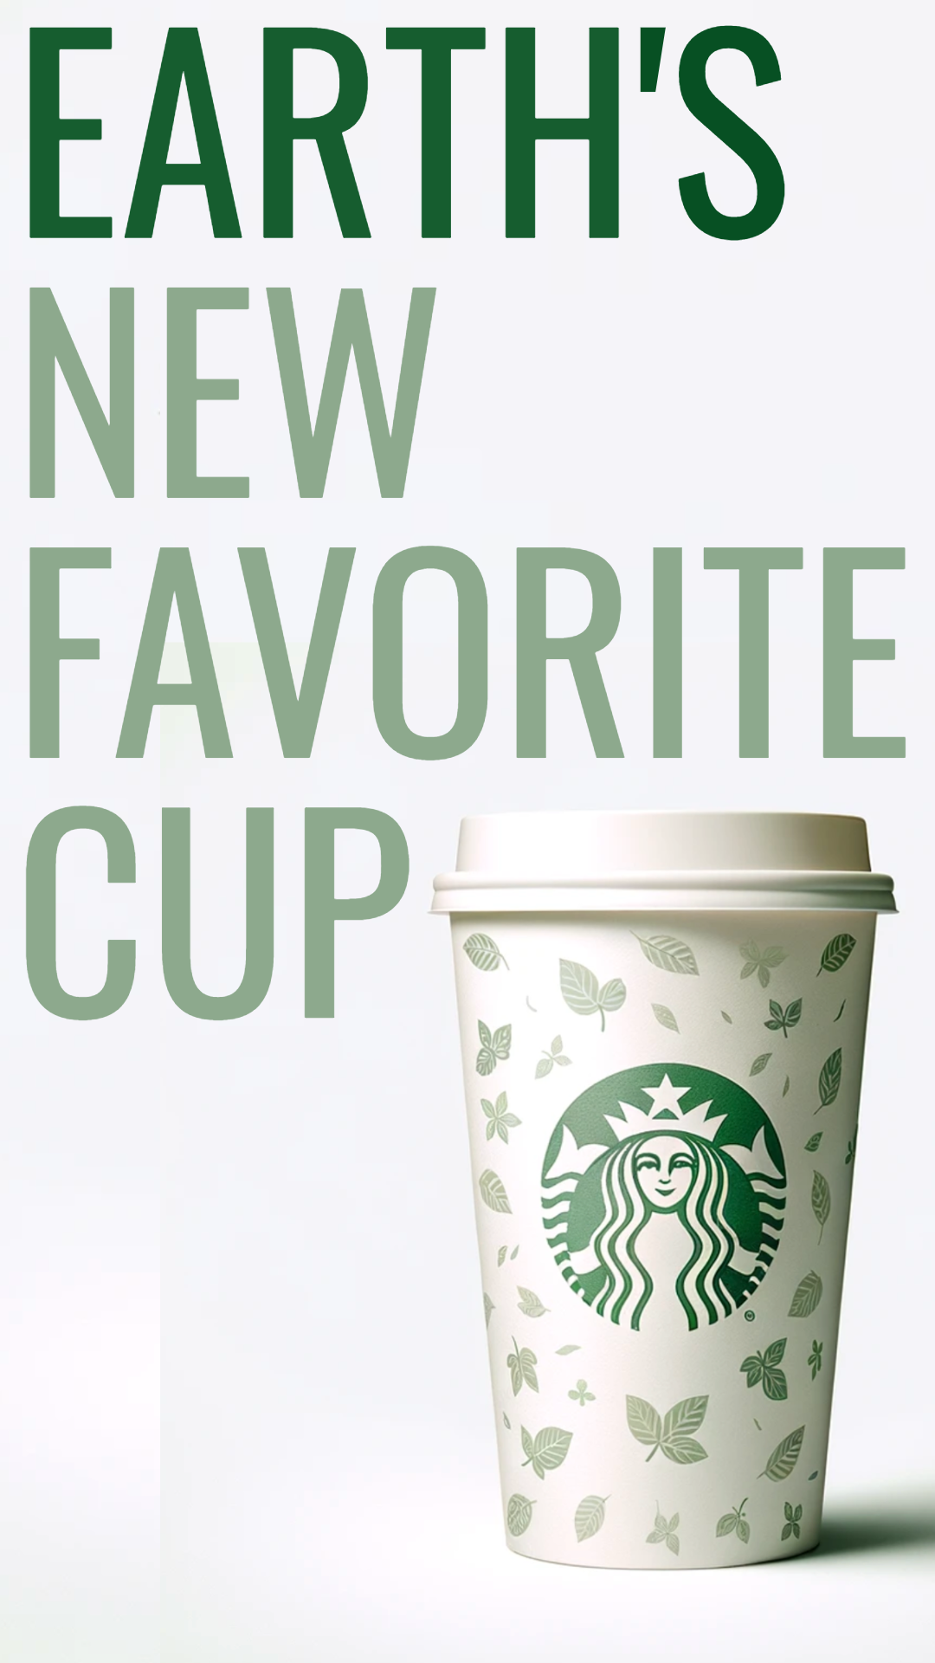
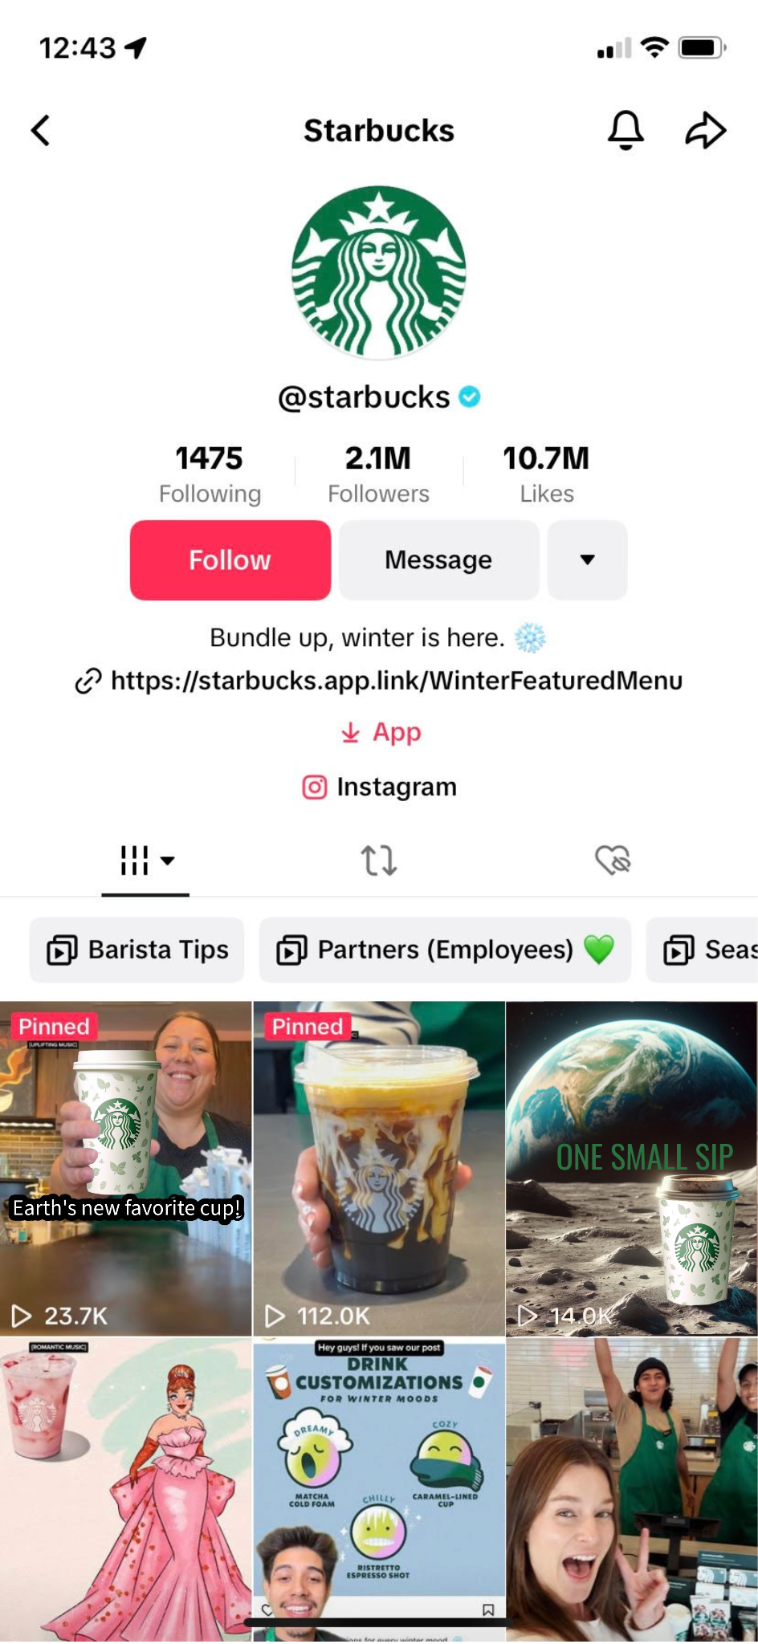
#OneSmallSip
Thank you!

Slide 23
Appendix
SLIDE 3:
https://github.com/owid/co2-data
SLIDE 7:
https://ourworldindata.org/fossil-fuels
SLIDE 9: https://www.epa.gov/system/files/documents/2023-05/Pulp_and_Paper_Profile_RY2021_05-04-2023%20508.pdf
SLIDE 11:
https://cbmjournal.biomedcentral.com/articles/10.1186/s13021-018-0110-8
https://en.wikipedia.org/wiki/Hemp#Paper
https://www.linkedin.com/pulse/hemp-really-next-big-thing-sustainable-paper-shailesh-ganeriwala

Slide 24
Appendix
SLIDE 12:
https://www.ncbi.nlm.nih.gov/pmc/articles/PMC5456447/
https://www.linkedin.com/pulse/hemp-really-next-big-thing-sustainable-paper-shailesh-ganeriwala
https://www.farmers.gov/your-business/row-crops/hemp
https://www.aph.gov.au/documentstore.ashx?id=ae6e9b56-1d34-4ed3-9851-2b3bf0b6eb4f#:~:text=Industrial%20hemp%20has%20been%20scientifically,and%20as%20a%20building%20material.
https://www.theguardian.com/environment/2022/nov/24/could-hemp-be-a-key-tool-in-fight-against-climate-change
SLIDE 13:
https://www.aph.gov.au/documentstore.ashx?id=ae6e9b56-1d34-4ed3-9851-2b3bf0b6eb4f#:~:text=Industrial%20hemp%20has%20been%20scientifically,and%20as%20a%20building%20material.
https://cfpub.epa.gov/ncer_abstracts/index.cfm/fuseaction/display.abstractDetail/abstract_id/10943/report/0
https://www.epa.gov/system/files/documents/2023-05/Pulp_and_Paper_Profile_RY2021_05-04-2023%20508.pdf

Slide 25
Appendix
SLIDE 14 - 19
https://stories.starbucks.com/uploads/2023/04/2022-Starbucks-Global-Environmental-Social-Impact-Report.pdf
https://stories.starbucks.com/uploads/2020/01/Starbucks-Environmental-Baseline-Report.pdf
https://content-prod-live.cert.starbucks.com/binary/v2/asset/137-88326.pdf
SLIDE 19 CALCULATION: 275.35 kilo-metric tons * 0.45 = 123.9075 kmt in cupstock / 3000000000 cups = 4.13025e-8 kmt/paper cup; 91% of 4.13025e-8 = 3.7585275e-8 kmt/hemp cup = 112.755 kmt in cupstock; ~11 kmt difference conv to lbs = ~24,250,000 lbs
SLIDE 20:
georgebenaroya.medium.com/starbucks-cost-for-a-coffee-is-1-unless-you-sit-4eb1153c1ee2
https://eiha.org/media/2016/05/16-05-17-European-Hemp-Industry-2013.pdf
SLIDE 21: https://inyova.ch/en/expertise/millenials-gen-z-and-sustainable-investing/#:~:text=86%25%20of%20Millennials%20are%20interested,investing%20could%20improve%20sustainability%20outcomes
https://money.cnn.com/2018/02/07/news/companies/dunkin-styrofoam-cups/index.html
https://recyclenation.com/2010/03/styrofoam-paper-cups/#:~:text=The%20trendy%20paper%20cup%20also,amount%20of%20money%20to%20produce.

Slide 26
Starbucks is a market leader
Their investment into and commitment to hemp paper production through a change in cups would allow for better infrastructure developments in the paper and pulp industry, which would further the adoption of hemp paper. Additionally, showing that this change is feasible within their business would show competitors

Slide 27
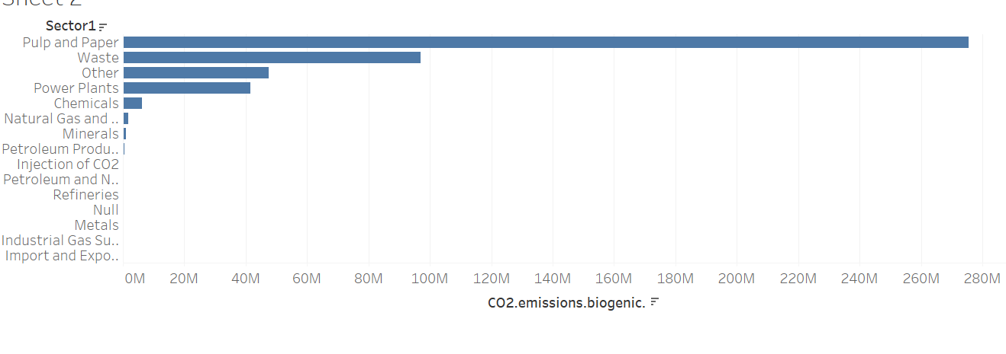
Pulp and paper has the most biogenic co2 emission out of all sectors

Slide 28
Investor Concerns
2/3rds of Millenials and Gen Z investors are deeply concerned about environmental and social issues
Millennials and Gen Z are willing to lose 6% to 10% of their investments to see companies improve their environmental practices. Baby Boomers are unwilling to lose anything.
86% of Millennials are interested in impact investing, and Millennials are twice as likely to invest in funds targeting social or environmental causes than the general population.
Around three-quarters (72%) of Gen Zers expressed hope that responsible investing could improve sustainability outcomes.

Slide 29
